Slide 1



Binary Classification of Job Posts
Distinguishing IT from Non-IT Roles
Ahmed Abdulrahim
Bimsara Siman Meru Pathiranage
Simranjeet Kaur
Efemena Theophilus Edoja
Himanshu

Slide 2
Problem Statement:
Objective: Develop a machine learning model to classify job postings as IT or non-IT based on textual content.
Challenge: Effectively process and analyze the nuanced language and terminologies used across various industries to ensure accurate classification.
Research Question:
Can a machine learning model reliably distinguish between IT and non-IT job posts using textual data, and what are the key features that influence this classification?
Problem Definition and Research Inquiry

Slide 3
Project Significance and Relevance
HR
Efficiency
Data Analytics Education
Job Search Optimization
Streamlines Recruitment: Automates the sorting of job postings, significantly enhancing HR efficiency.
Theory to Practice: Provides practical experience in NLP and machine learning within real-world contexts.
Enhanced Targeting: Filters out non-relevant job postings, improving efficiency and relevance in job searches.

Slide 4
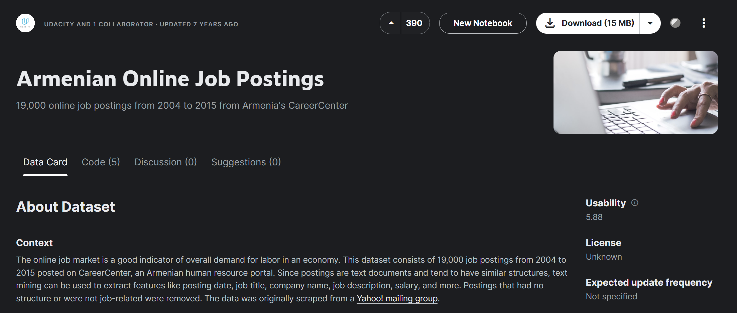
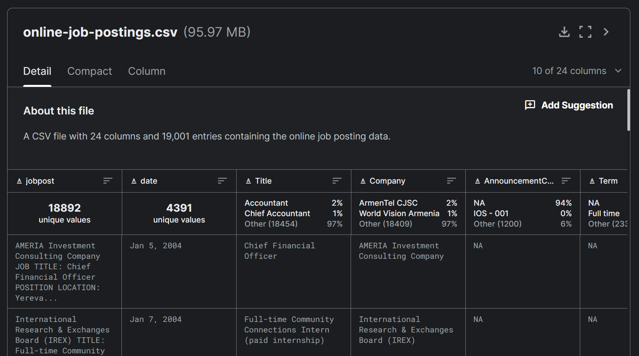
Data Source
Brief Overview: This dataset contains 19,000 structured job postings from 2004 to 2015, sourced from CareerCenter, an Armenian job portal, and includes key details like job titles, company names, and descriptions.
Data Collection
Our dataset is sourced from Kaggle and consists of 24 columns, including a 'Job Post' column that encompasses the entire job listing. Another key column, 'IT', is a Boolean field indicating whether the job is IT-related, encompassing roles such as computer science, software engineering, data analysis, network administration, and cybersecurity.

Slide 5
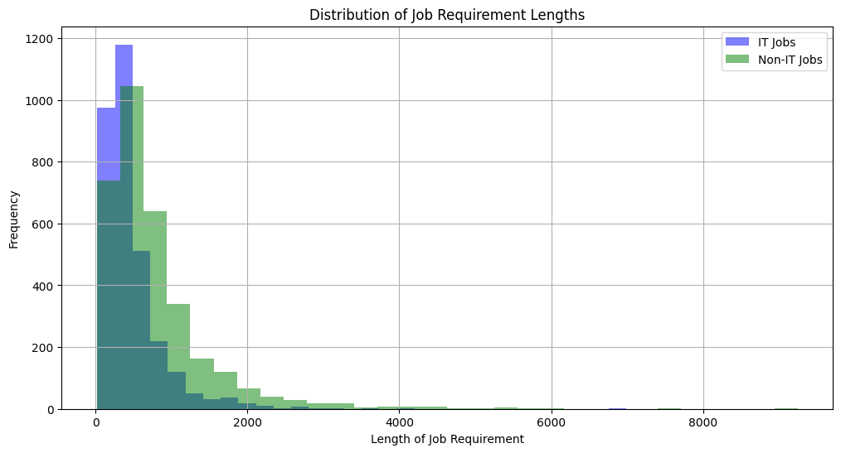
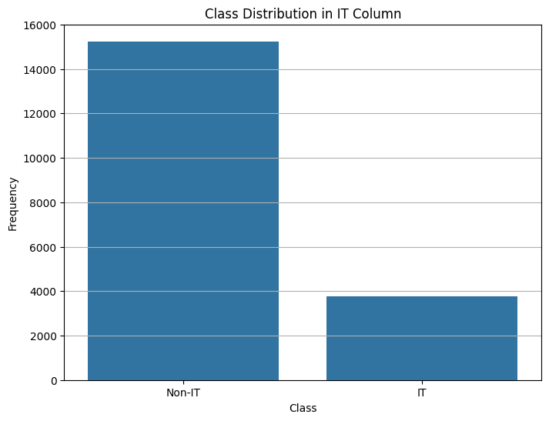
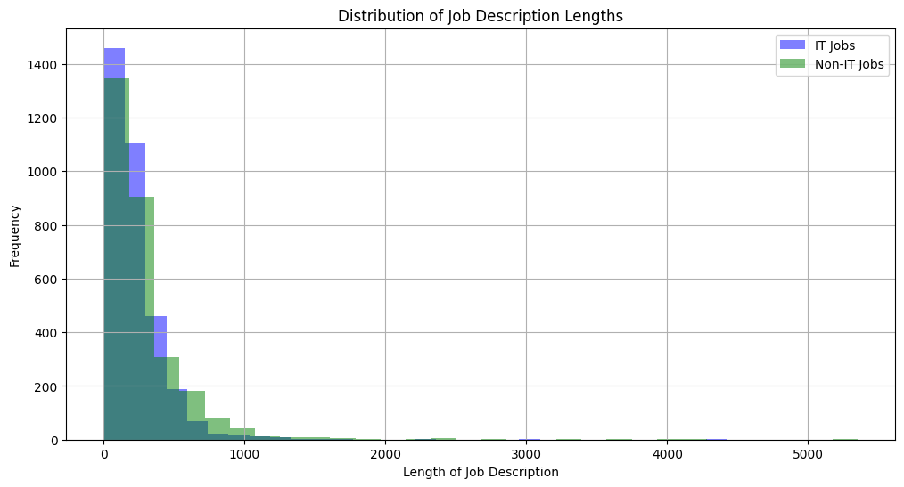
Data Exploration

Slide 6
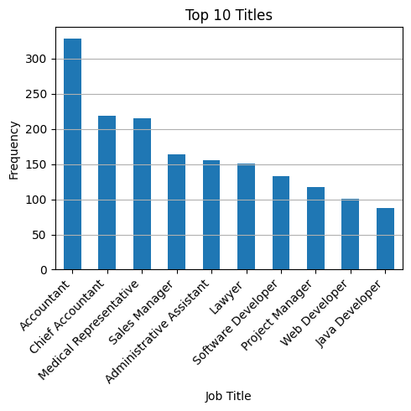
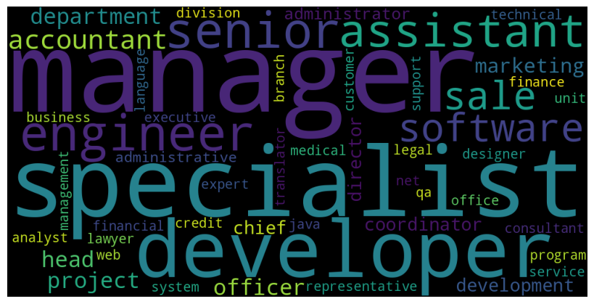
Data Exploration
Job Title Tokens WordCloud

Slide 7
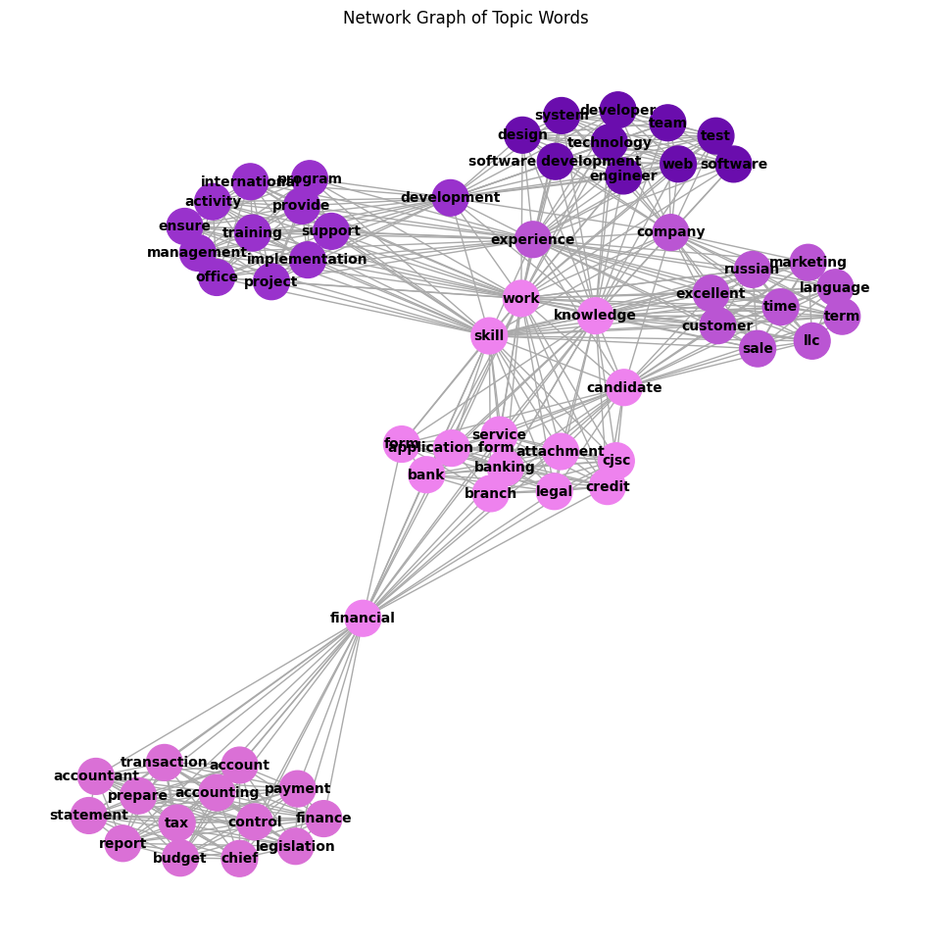
Data Exploration
Topic Modeling with LDA: Leveraging Latent Dirichlet Allocation (LDA) to identify prevalent topics in job postings.
Latent Dirichlet Allocation (LDA) technique, is a type of topic modeling, to analyze and understand the main themes or natures of jobs from tokenized job postings. The goal is to identify clusters of words that represent significant topics within the job posts, which can help in understanding the nature and profiles of jobs.

Slide 8
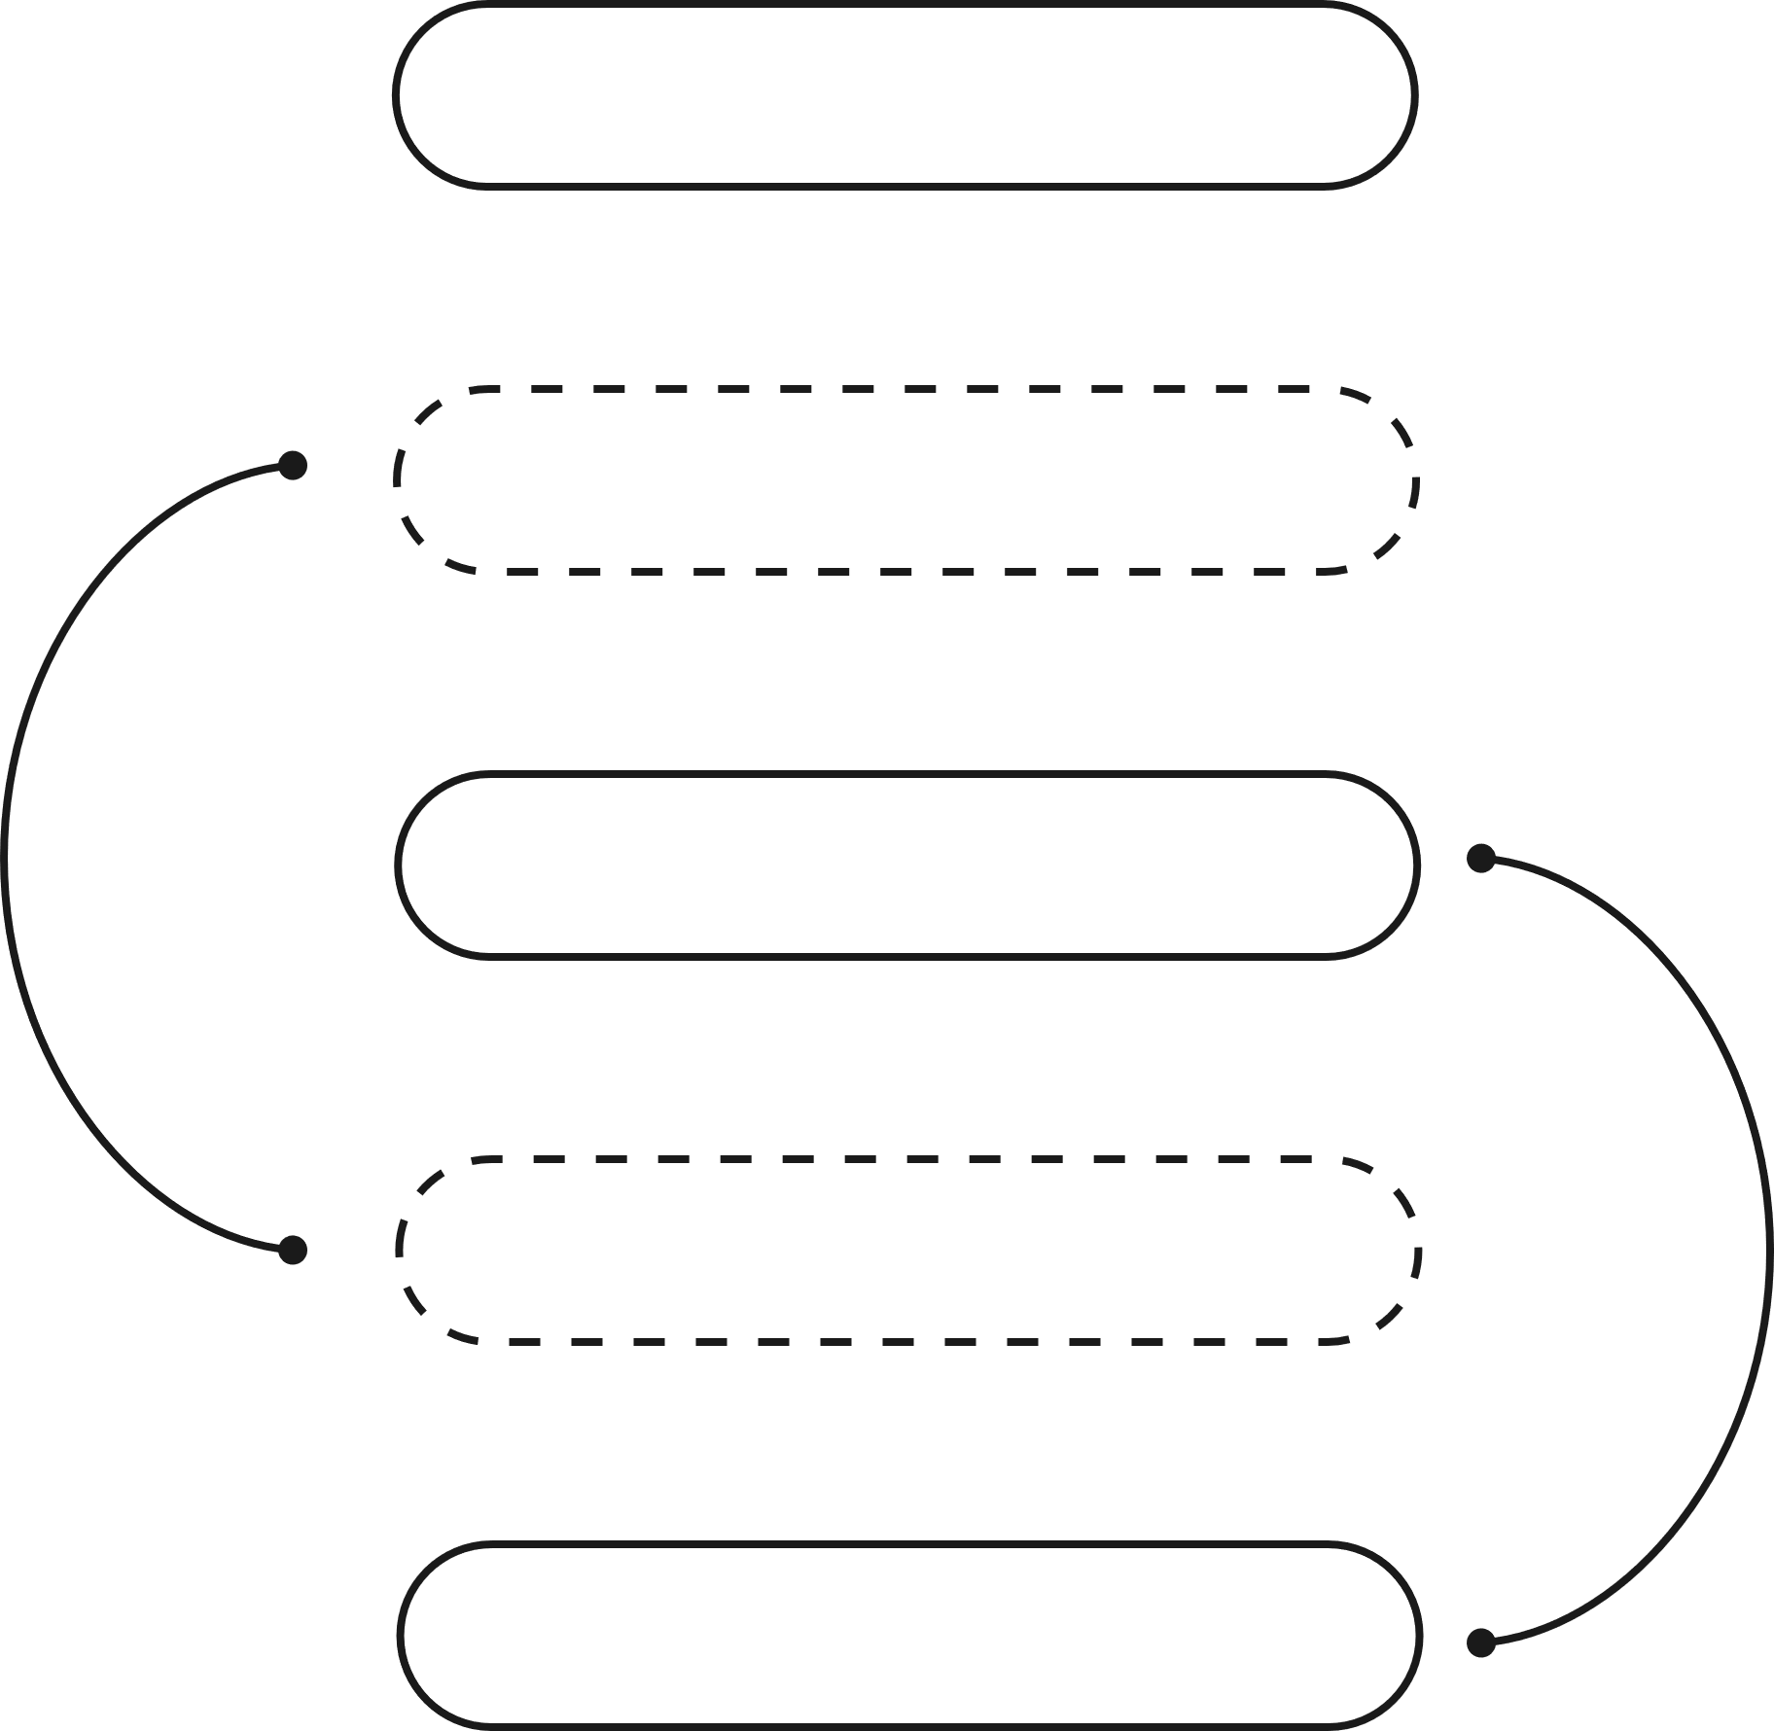
Remove Punctuation & Digits
Data Preparation
Feature Extraction:
TF-IDF (Term Frequency-Inverse Document Frequency): Quantifying the importance of words relative to their frequency across all documents.
Data Balancing:
Apply SMOTE (Synthetic Minority Over-sampling Technique) to balance the distribution of IT and non-IT job labels.
Standardize Text
Tokenization
Lemmatization
Remove Stop Words

Slide 9
Modeling
Random Forest: max_features=25, n_estimators=180
RNN: Embedding layer (128 units), LSTM layer (64 units), Dense output layer with softmax activation.
Model | Dataset | Accuracy | Precision | Recall | F1 Score | ROC-AUC Score
Random Forest | Train | 0.9986 | - | - | - | 0.9986
 | Test | 0.9626 | - | - | - | 0.9290
RNN | Train | 0.9796 | 0.9709 | 0.9651 | 0.9680 | -
 | Test | 0.9244 | 0.8776 | 0.8804 | 0.8790 | -

Slide 10
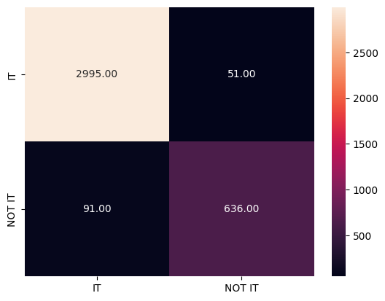
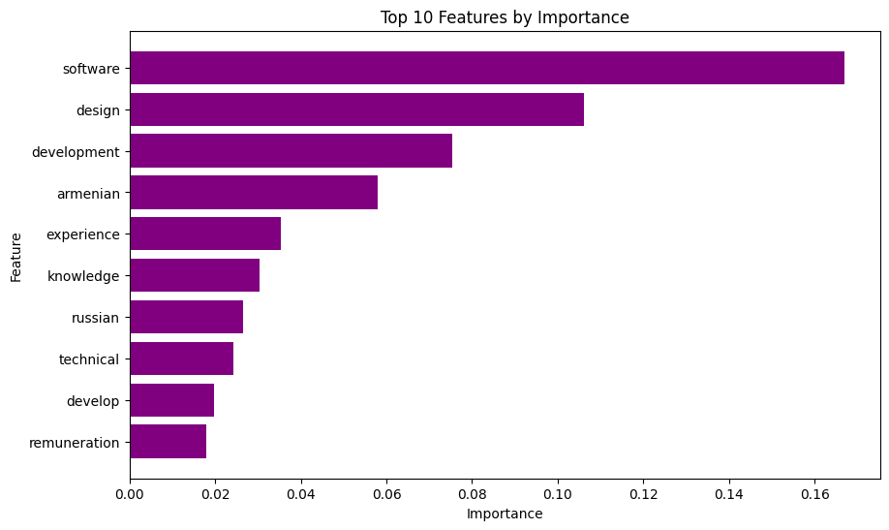
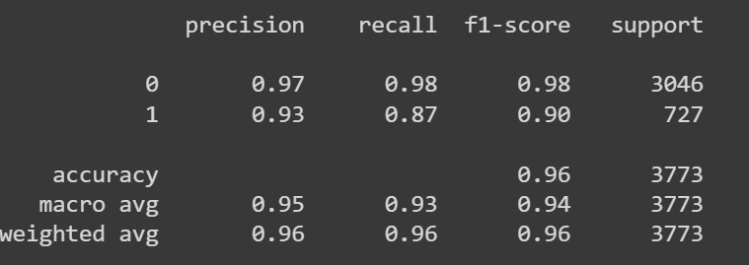
Model Evaluation
Random Forest

Slide 11
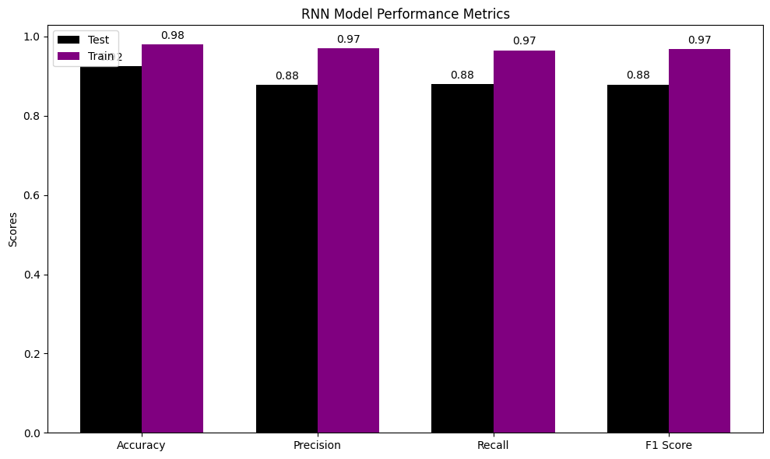
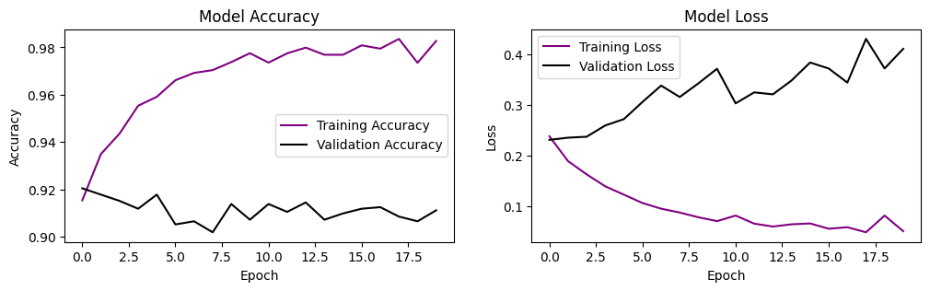
Model Evaluation
Recurrent Neural Network

Slide 12
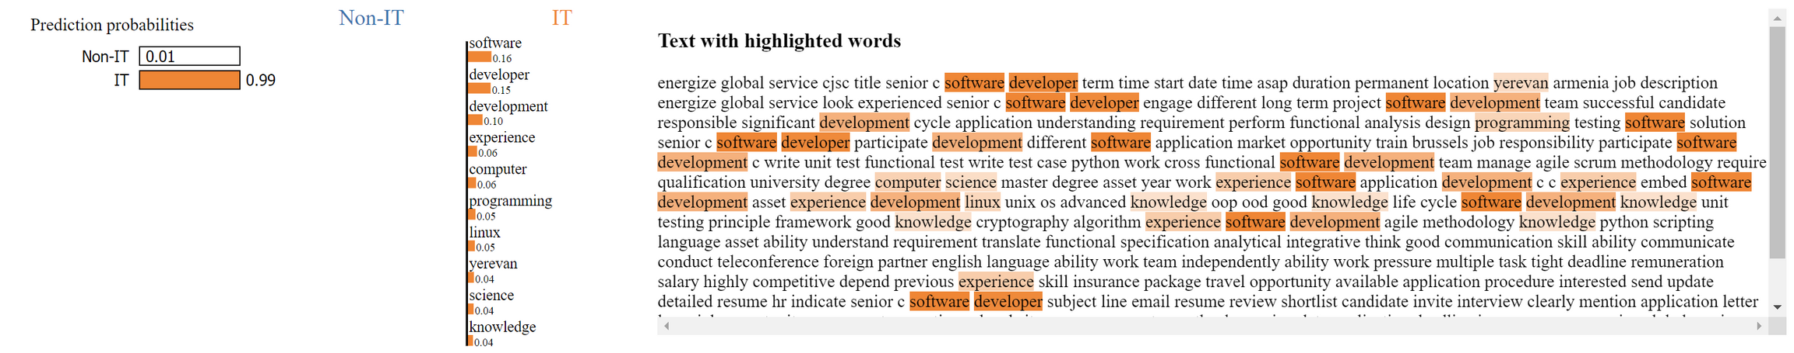
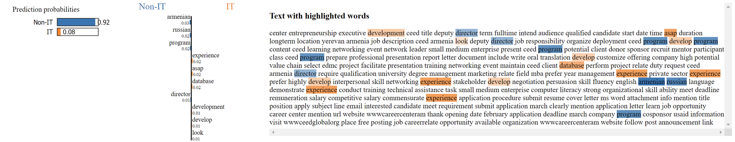
LIME
Local Interpretable Model-Agnostic Explanations

Slide 13
Discussion: Results & Limitations
Key Findings
The application of LDA revealed distinct topics within the job postings dataset, with a clear demarcation between IT-related and non-IT-related roles.
Limitations
The dataset included labels solely for IT roles, lacking categorization for other job sectors that could have provided deeper insights into industry-specific keywords and features.
Model Performance
The RNN model demonstrated dependable performance in identifying IT roles with 92% accuracy, while the Random Forest model outperformed with a 96% accuracy and 94% macro-average F1 score, indicating its robust classification capabilities.

Slide 14
Kaggle. (n.d.). Armenian online job postings. Retrieved from https://www.kaggle.com/datasets/udacity/armenian-online-job-postings?select=online-job-postings.csv
GeeksforGeeks. (2024). ML linear discriminant analysis. Retrieved from https://www.geeksforgeeks.org/ml-linear-discriminant-analysis/
Ribeiro, M. T., Singh, S., & Guestrin, C. (n.d.). “Why should I trust you?” Explaining the predictions of any classifier. Retrieved from https://homes.cs.washington.edu/~marcotcr/blog/lime/
Soshace. (n.d.). NLP preprocessing using SpaCy. Retrieved from https://soshace.com/nlp-preprocessing-using-spacy/
References

Slide 15

THANK YOU!

